Slide 1
Getting Started
GITHUB REPOSITORIES
And PROJECTS

Slide 2
Topics
Create a GITHUB User
Project Manager – create REPOSITORY
Project Manager – create PROJECT for REPOSITORY
Install Git
Git Config
VSCODE extensions for GITHUB and COPILOT
Attach you GITHUB Account to your VSCODE
GITHUB Education – get COPILOT free
TEAM clones the PMs Repository
Issue, Assign, Branch, Publish, Sync

Slide 3
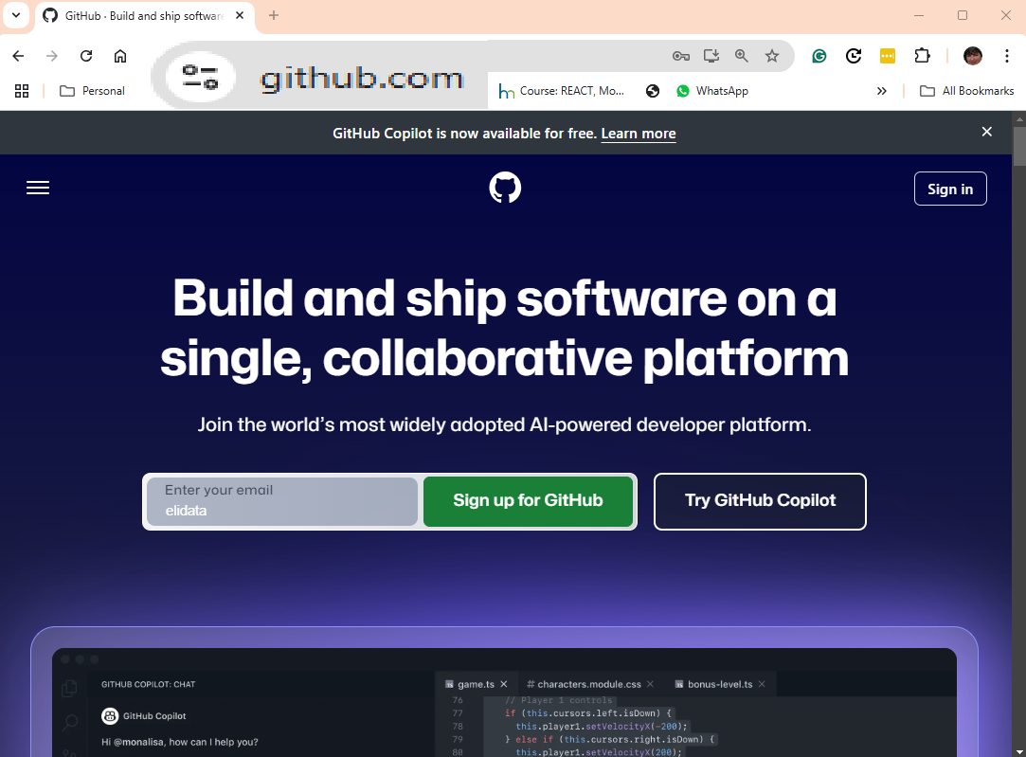
Create a Github User at GITHUB.COM

Slide 4
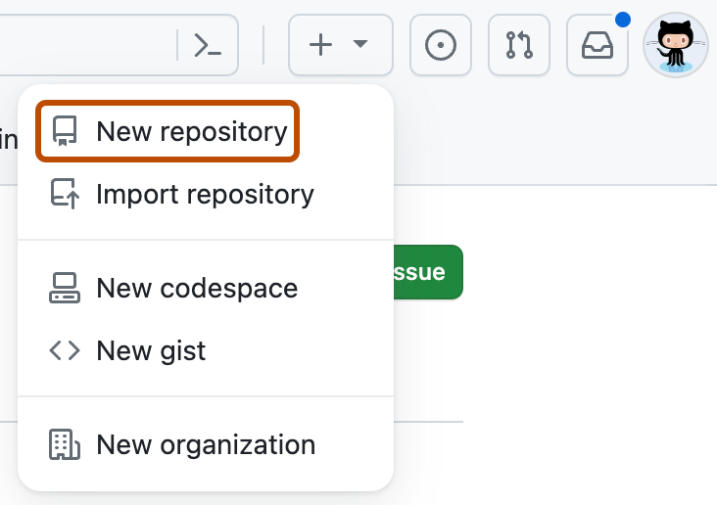
Project Manager Open a Repository for the Project
.
In the upper-rightcorner of any page, select , then click New repository
In the "Repository name" box, type a name for your project. For example, type "my-first-project."
In the "Description" box, type a short description. For example, type "This is my first project on GitHub."
Select whether your repository will be Public or Private. Select "Public" if you want others to be able to see your project.
Select Add a README file. You will edit this file in a later step.
Click Create repository.
Add source files (drag and drop/upload)
In Settings – Add Collaborators (emailconfirmation needed)

Slide 5
Project manager – Open a Project
Give it a name and open board
Give access to Team members
Go back to the repository and link it to the Project
Issues are created in the repository
Issues are assigned and managed in the Project

Slide 6
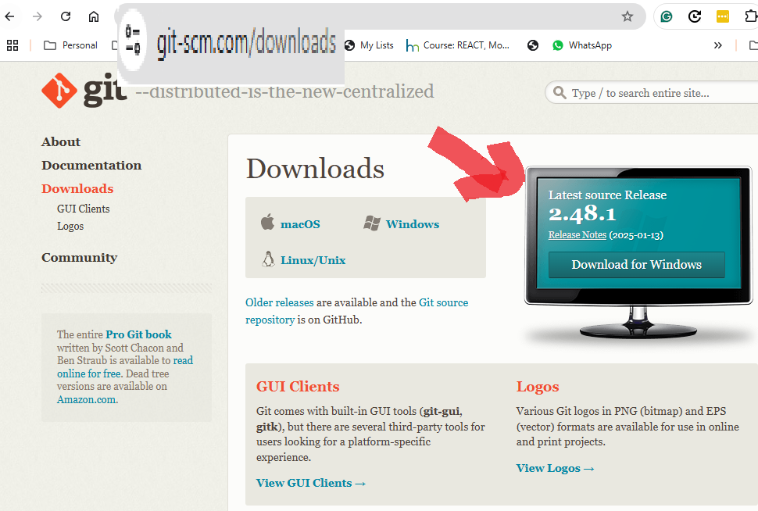
Install
GIT

Slide 7
Settings git user/email for all repositories
Open Git Bash. (or terminal)
Set a Git username and email:
git config --global user.name "Mona Lisa"
git config --global user.email "MonaLisa@gmail.com"
Confirm that you have set the Git username correctly:
git config user.name
git config user.email
Restart VSCode to take effect

Slide 8
Adding an SSH to GITHUB
Generate an SSH key on your computer
Copy the SSH key to GITHUB
  Profile → Settings → SSH and GPG keys → New SSH key → paste and save.
To check the ssh key is set correctly
  $ ssh -T git@github.com

Slide 9
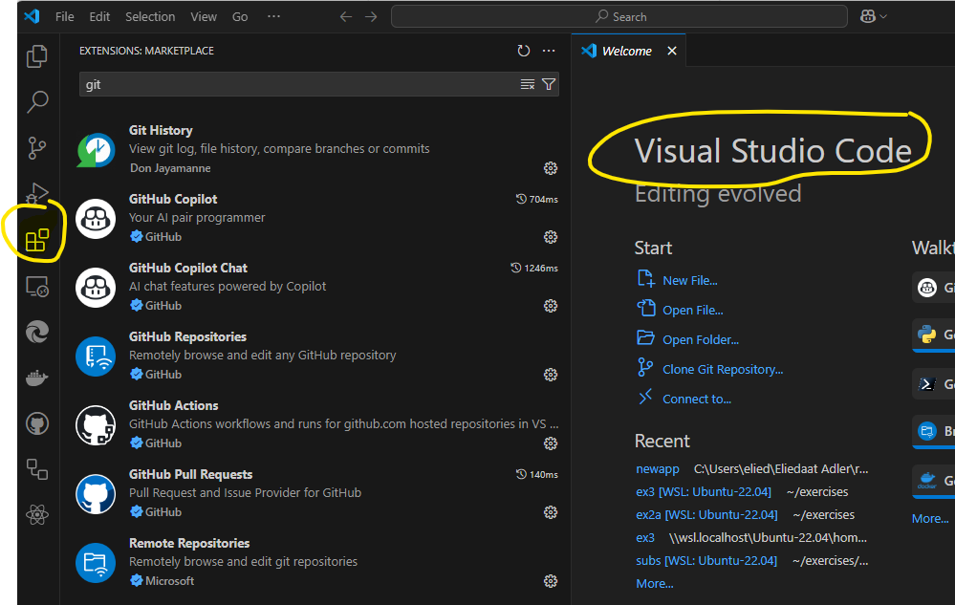
Github/Copilot Extensions in VSCODE

Slide 10
Attach VSCODE to GITHUB
Follow the instructions – This gives you all the necessary GIT actions and queries in VSCODE .

Slide 11
GitHub AI Tools for Students
✅ Get Started
Join the GitHub Student Developer Pack:
education.github.com/pack
Gain access to Copilot, Codespaces, and more—for FREE!

Slide 12

GitHub Copilot
AI-powered coding assistant that autocompletes code as you type.
Supports multiple programming languages with smart suggestions.
FREE for students via the Student Developer Pack.
👉 Setup: github.com/features/copilot

Slide 13

💬 GitHub Copilot Chat
Ask coding questions and debug issues directly in your IDE.
Provides AI-powered explanations, code improvements, and optimizations.
Accessible with a Copilot subscription
    (FREE for students).

Slide 14
💻 GitHub Codespaces + Copilot
Cloud-based development environment with instant setups.
Fully integrates GitHub Copilot for real-time code suggestions.
Saves time—no local setup required,
FREE for students.
👉 Learn More: github.com/features/codespaces

Slide 15
🔒 Dependabot
Automates dependency updates and security fixes in your repositories.
Keeps projects secure by scanning for vulnerabilities automatically.
Enabled by default for all GitHub repositories.

Slide 16
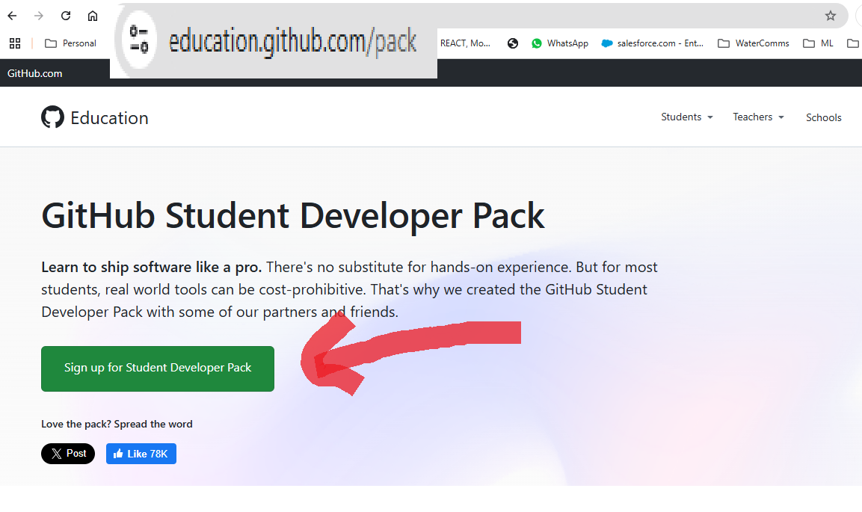
Get CoPilot Pro for Students – Free!

Slide 17
Demo
Issue (PM)
Assign(PM)
Branch,
Changes,
Publish (Or pull-request and review)
Sync

Slide 18
Nice to Meet You
Eliedaat Adler - elidaatad@post.jce.ac.il
הנדסת תוכנה בשירות הקהילה – שנה הרביעית
30 Years Software Programming - Oracle, NDS, Cisco
Data Specialist but also embedded, IOT, Analytics
8 Years ההייטק החברתי
Mentor Student Project and Early Startups

